Slide 1
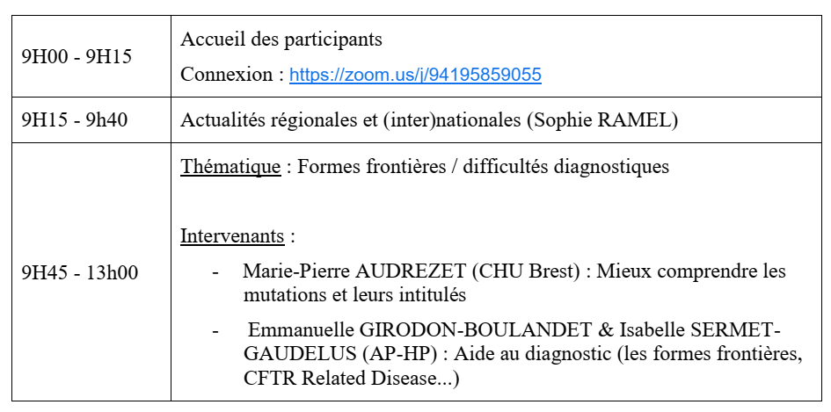
Reunion 16/03/21

